Slide 1
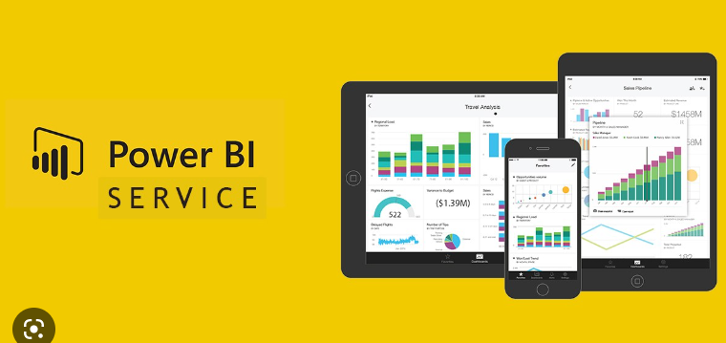

Slide 2
PBI Desktop vs Service
Power BI Desktop is a free application you can download and install on your local PC. You can use Power BI Desktop to connect to, transform, and visualize your data. Furthermore, you can analyse your data and develop reports. The Query Editor in Power BI Desktop manages the connections to the data sources. It can structure, clean, merge, and append data. You are then able to combine the data into a relational data model. From the data model, you can design reports using the visualisation tools in Power BI Desktop. Power BI Desktop is the only app of the two which allows the creation of DAX (Data analysis eXpressions) measures, calculations, and column calculations. You can set up role level security (RLS). You can use RLS to manage the data each person in the audience has access to in a published report.
The Power BI Service is known as Software as a Service (SaaS), which is a cloud-based service. You can edit reports, share the reports with your audience, and collaborate with teams and organizations. You can connect to certain data sources, but its modelling capability is limited. The Power BI Service cannot perform DAX measures, calculations, or column calculations. However, you can create dashboards from multiple reports using Power BI service. Furthermore, it is possible to create and distribute apps, reveal business insights, and much more.
Notes:
https://www.sqlshack.com/introduction-to-the-power-bi-service/

Slide 3
Overview of Power BI Service
The Power BI Service is known as Software as a Service (SaaS), which is a cloud-based service. You can edit reports, share the reports with your audience, and collaborate with teams and organizations.
Power BI Desktop is a free application you can download and install on your local PC. You can use Power BI Desktop to connect to, transform, and visualize your data. Furthermore, you can analyse your data and develop reports

Slide 4

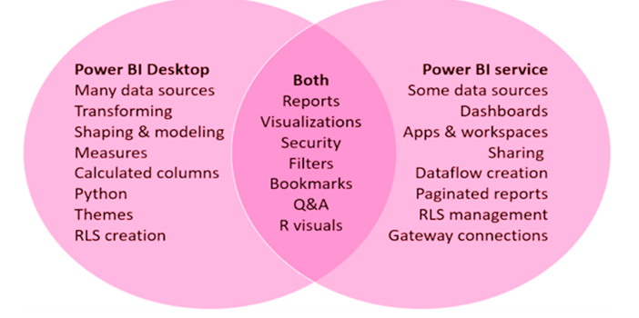
PBI Desktop vs Service

Slide 5

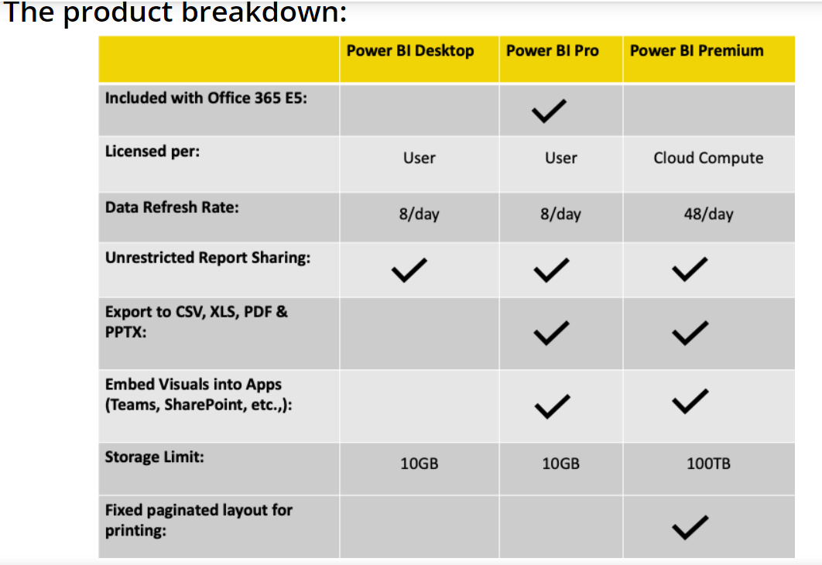
PBI Desktop vs Pro vs Premium

Slide 6
About Power BI Service
Power bi service is a cloud-based service i.e SAAS (Software as a service)
URL to login power bi service is app.powerbi.com
When you publish .pbix files from pbi desktop it will publish into power bi service
Power bi service you can manage workspaces
In powerbi service only you can create dashboards
Power BI uses two primary repositories for storing and managing data:
Data that is uploaded from users is typically sent to Azure Blob Storage, and all
metadata as well as artifacts for the system itself are stored in Azure SQL Database.

Slide 7
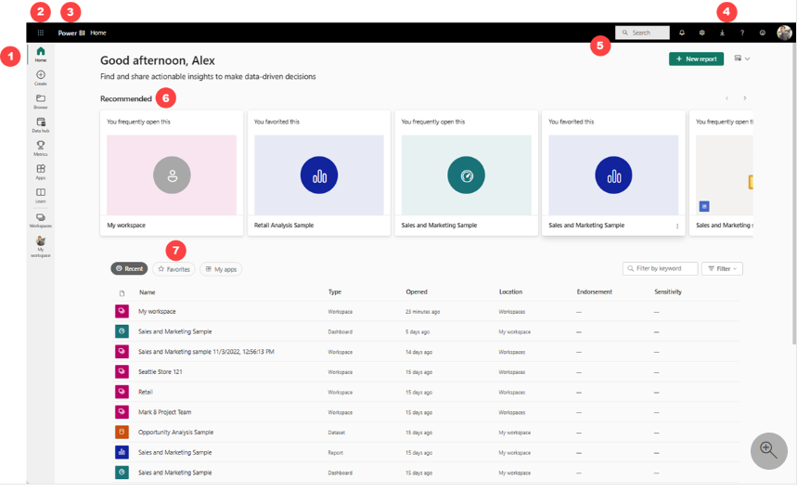
Power BI Service _ Home page
The Power BI service runs in a browser.
open your favorite browser and type app.powerbi.com
Enter your credentials to access Power BI Service
Notes:
https://learn.microsoft.com/en-us/power-bi/fundamentals/service-basic-concepts

Slide 8
Power BI Service Terminologies
Data Source
Data sets
Report
Dashboard
Workspace
Pipelines
Score cards / Metrics
Gateways
Tiles

Slide 9
Contd..
Data source:
Data source is the one where you connect the data from
Ex like .xls, csv, SQL server, azure sql database.
Dataset:
Dataset is the one when you loaded the data into powerbi
Ex of dataset : Sales data
Reports:
Reports are the collection of pages which has visualizations

Slide 10
Contd..
Dashboards:
Dashboards is elements from the report
Single page which is static in nature, which tells the entire story to tell the user.
Dashboard can be created only in Power BI service not in PBI desktop.
Tiles : Tiles are snapshot of your data pinned to dashboard
Workspace : Both reports and dashboards needs workspaces to store.
Pipelines : Deployment pipelines enable creators to develop and test Power BI content in the Power BI service, before the content is consumed by users.

Slide 11
Report vs Dashboards
Reports | Dashboards
Reports can have multiple pages | Dashboard can have only one page
Each report will have only one dataset | Dashboard is a planned visual, so dashboard can get visual from one or more datasets
In Reports we can do filtering and Slicer | In Dashboards options are very limited no such features such filters and slicers
Reports are interactive | Dashboards are non interactive
Reports are not limited; it has a detailed breakup of each category of data in multiple pages Ex : Drill through | Dashboards include only limited information which is needed to the user

Slide 12
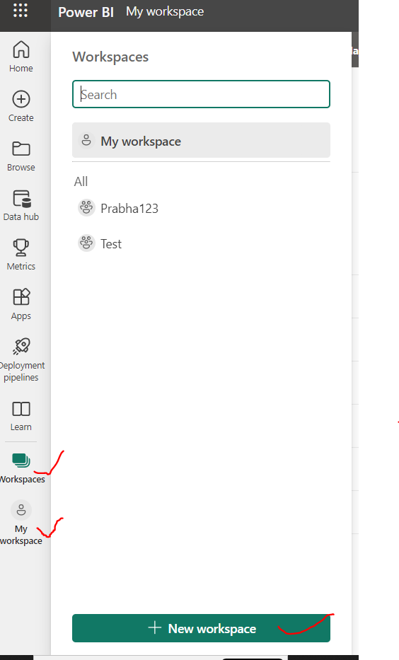
Working with Workspaces
Workspaces are used to store the power bi reports , dashboards, datasets and to collaborate with colleagues.
Workspaces are of Two types
1. My workspace
2. Workspace

Slide 13
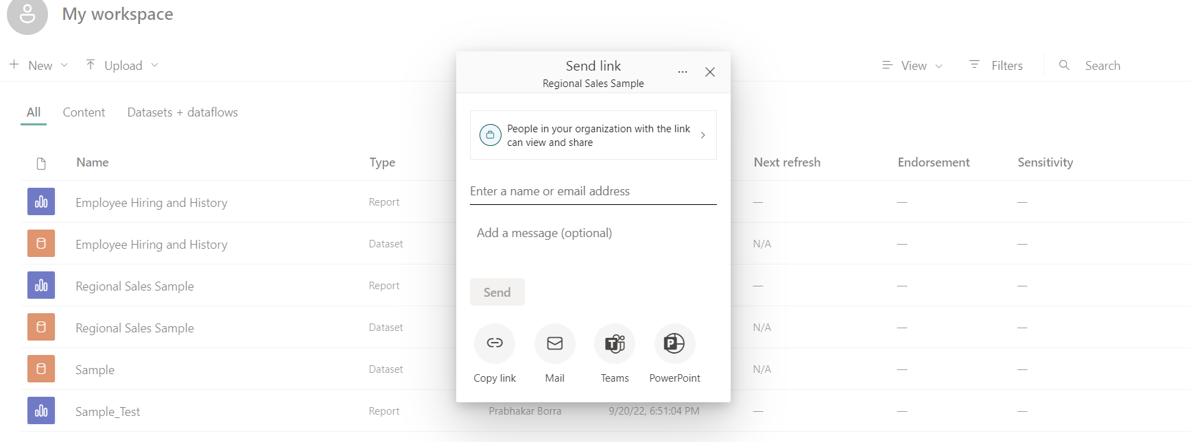
My Workspace (Private workspace)
My workspace : It is the personal workspace for any power bi developer to work with your own content . Only you have the access to your My workspace.
You can share the reports and dashboards from the My workspace.
But if you want to collaborate on dashboards and reports, or create an app then you want to work in a workspaces (Real time working)

Slide 14
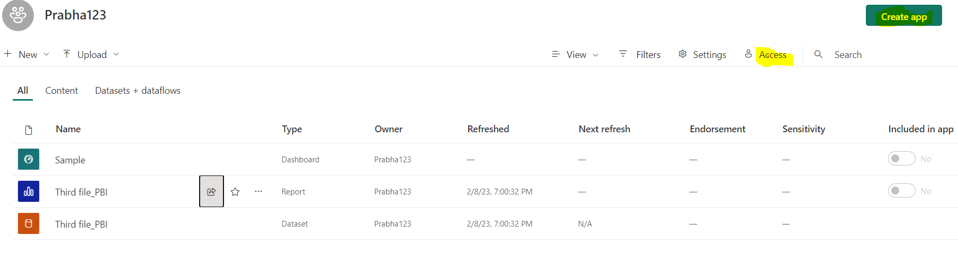
Workspace (Public workspace)
Workspaces are used to collaborate and share content with colleagues.
You can add colleagues to your workspaces and collaborate on dashboards, reports, workbooks , and datasets.
With one exception, each workspace member needs a Power BI Pro or Premium Per User (PPU) license.

Slide 15
Workspace Roles
There are 4 Types of Roles
1) Admin (Highest Privilege)
2) Member ( can see all information and now he can add another person)
3) Contributor ( can see all reports, datasets and dashboards but not possible
to add any other person
4) Viewer ( only can see reports, Don’t see data sets)

Slide 16
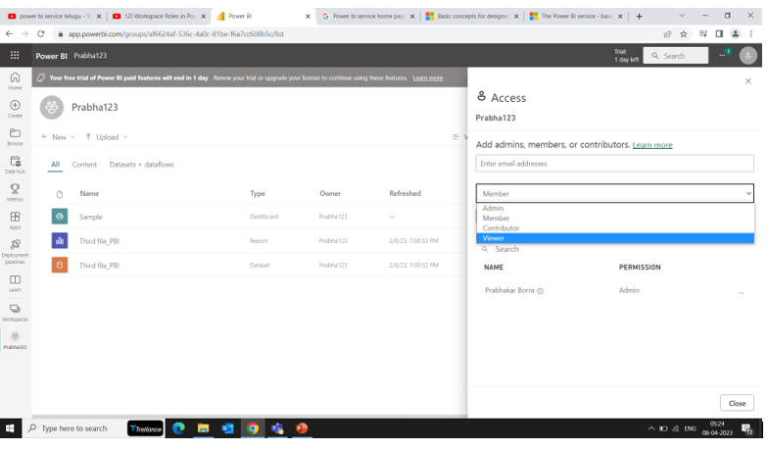
Works space _ Roles

Slide 17
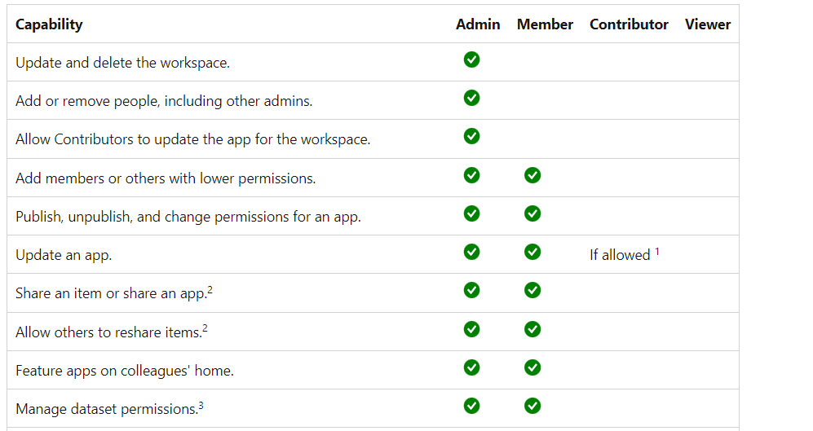
Roles

Slide 18
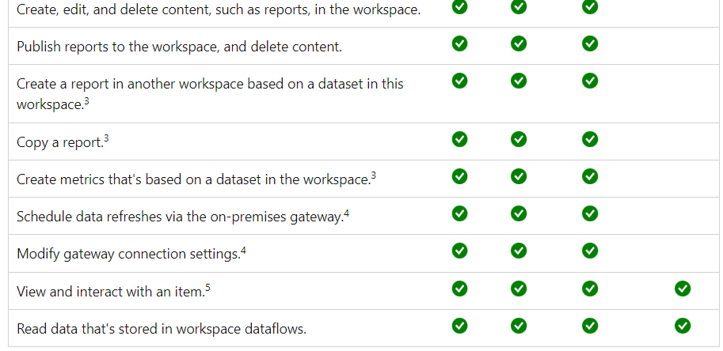
Contd..

Slide 19
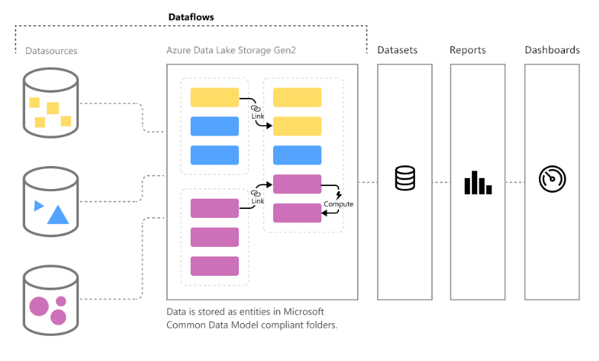
Data flows
Data flows are online power query editor in PBI Service
Data flow is Self service ETL, where you can apply transformations.
Data flows are stored in Azure data Lake storage Gen2
Dataflows are not dataset
Dataflows are source for dataset
Notes:
https://www.youtube.com/watch?v=5N4Fq_0OZpY

Slide 20
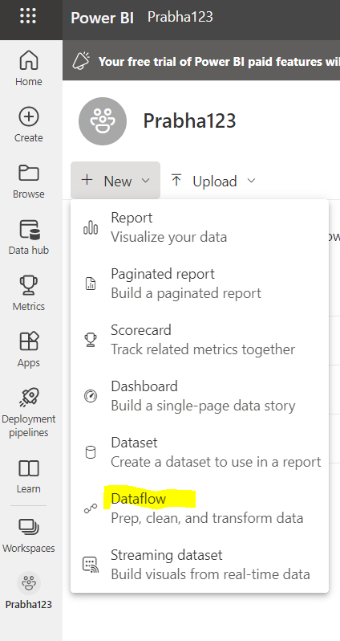
Eligibility to use Dataflows
You should have an organizational workspace
You should enable dataflows in admin portal
For on-premise data source files, you should have a Standard gateway
installed in your machine and it should be mapped to your service account
You should have pro or premium account

Slide 21
Row Level Security (RLS)
Row Level Security : Restricting the data access to particular user is known as RLS
Row Level Security is of Two Types
1. Static RLS
2. Dynamic RLS
Roles are defined using Power BI Desktop
Roles are designed to limit data seen by a particular user
DAX expressions restrict which rows are accessible

Slide 22
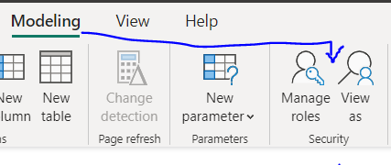
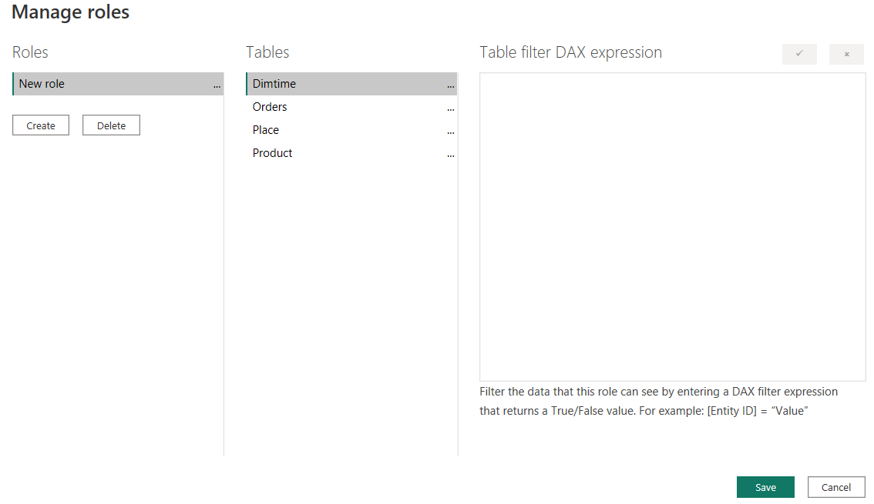
How to Create Static RLS
In Power BI Desktop go to Modeling tab
In that click on Manage roles
Next Create a new role and add the table and add DAX Filter Expression

Slide 23
Dynamic Row Level Security
Static RLS is only limited scope like small organization and if business requirement is constant.
But if business requirement is keep on changing and has more
Number of users static RLS is not a good choice. The solution is Dynamic Row Level Security

Slide 24
Contd..
Dynamic Row Level Security is handled by two DAX Functions mainly.
1.USERPRINCIPALNAME()
2. USERNAME()
By using these functions, you are not hardcoding at power bi desktop level all will be handled at backend level itself

Slide 25
Apps in Power BI service
An app combines related content – dashboards and reports all in one place.
An app can have one or more of each content type, all bundled together.
These are done by the power BI Designer/ Developers/Admins
You can create only one app per workspace.

Slide 26
Subscriptions in Power BI
By Using subscriptions Users can view the reports, dashboards and paginated reports in an email which contains the snapshot of that report and report link.
We can send email based weekly, daily or custom dates as per the business needs.

Slide 27
Create Report in Power Bi Service
We can Create Visualizations in Power BI Service same as in PBI Desktop.
But PBI Service does not support Calculated Columns and Measures.
PBI Service does not support the Power Query editor transformations, Model tab and data tab not visible.
In PBI Desktop we can connect to multiple sources , but in pbi service we can't.

Slide 28
Gateways in Power BI
Which acts as Interface between Cloud and On-Premise data (Local excel local sql database)
Gateways are used for refreshing and showing the latest data from on-premise to cloud
In Power bi there are 2 types of Gateways
Standard mode (Enterprise mode) , Personal mode
Each mode having there own advantages
If your data resides in cloud, then no need of gateways

Slide 29
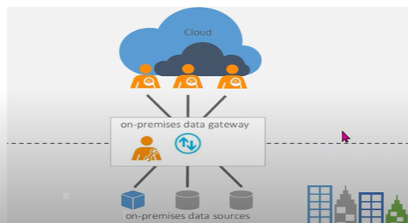
Contd..
These days companies are migrating data from on-premise to cloud, so in cloud no need of gateways.
Real time mostly 90% organizations don’t use gateways.

Slide 30
Schedule Refresh
Getting the latest data from on-premise (local excel, local sql server) to the cloud (app.powerbi.com)
We can schedule the refresh in app.powerbi.com
In Pro we can schedule 8 times per day
In Premium we can schedule 48 times per day
In order to schedule refresh for on-premise a gateway must be installed.

Slide 31
Share Power BI report to Public/ Friend
Open a report in a workspace that you can edit and select File > Embed report > Publish to web (public).
If your Power BI admin hasn't allowed you to create embed codes, you may need to contact them.

Slide 32
Persistent Filters
The meaning of Persistent is “Continuing to exit or occur over a prolonged period
Persistent filters applied it retains there state, including filters, slicers and other data view changes
By default, it is in uncheck mode (i.e., Persistent filters applied)

Slide 33
Embed Power BI Reports into Website
With the Embed Option in Power BI reports, you can easily embed A power bi reports into a website.
In Order to user Embed Option , You must have either Power BI Pro Or Premium License.

Slide 34
Data Alerts
It sends the alert when your data in dashboard changes the limit beyond you set
Alerts can be set only for KPIS , Gauge , Card Visuals in Dashboard pinned tiles.
Alerts only work with Numeric datatypes
When can manage these alerts by using Manage Alerts option

Slide 35
Power BI Service Live Connection
You can establish a live connection to a shared dataset in power bi service and create many different from the same dataset
You can create your data model, calculated columns, measures and then publish that dataset into the pbi service
Your colleagues can use that dataset as live connectivity and can develop there own reports accordingly business

Slide 36
Metrics
Knowing about the usage and performance of your workspace is crucial because it.
Focusses your efforts for improvement
Quantifies the impact of your reports
Usage Metrics helps you determine your reports success

Slide 37
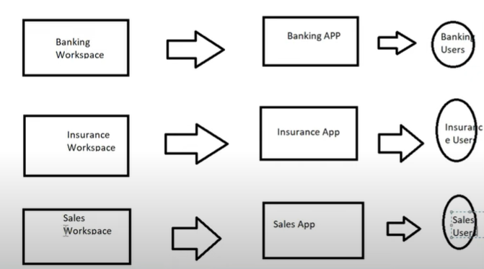
Multiple Audience Feature
Multiple Audience feature is the newly added in August 2022.
With Multiple Audience feature a Power BI App author can create multiple audience group within the same app and assign different permissions to each group.

Slide 38
Lineage View
Lineage view in Power BI service gives you a single relation view of all the data and visual building blocks of power bi workspace
The main use of this is Troubleshooting
Analysis of the flow of data from the initial data source to the end

Slide 39

Power BI Certification Exam Details
Exam code : PL-300: Microsoft Power BI Data Analyst
Passing score: 700
Exam cost : Rs.4800/-
Skills measured as of January 31, 2023
Prepare the data (25–30%)
Model the data (25–30%)
Visualize and analyze the data (25–30%)
Deploy and maintain assets (15–20%)

Slide 40
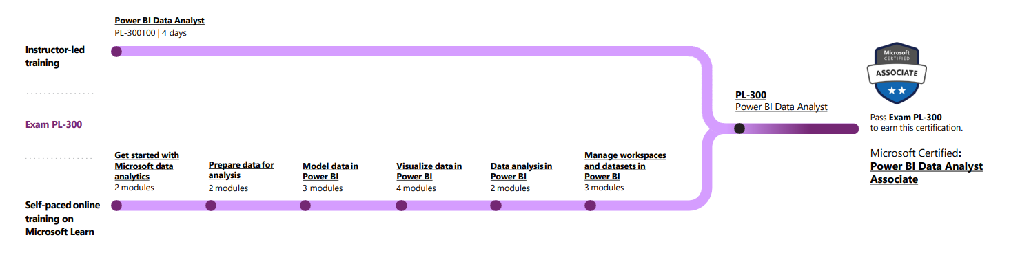
Certification PL 300_ Learning Path
Resource : https://learn.microsoft.com/en-us/certifications/power-bi-data-analyst-
associate/?WT.mc_id=PP_BoM-wwl

Slide 41
References for Certification exam
References:
https://learn.microsoft.com/en-us/certifications/exams/pl-300/
https://learn.microsoft.com/en-us/certifications/resources/study-guides/PL-300

Slide 42
Quiz Time
https://www.dailyrecruitment.in/power-bi-mcq-quiz-questions-and-answer-pdf-download/
https://www.freshersnow.com/power-bi-mcqs-and-answers-with-explanation/
https://github.com/Ebazhanov/linkedin-skill-assessments-quizzes/blob/main/microsoft-power-bi/microsoft-power-bi-quiz.md
https://www.studocu.com/in/document/siksha-o-anusandhan-university/electronics-and-communication-review/power-bi-mcq-quiz-with-answer-pdf/39729302

Slide 43
Quiz Contd..

